Slide 1
MUL Improvement: Karatsuba Algorithm
Let X = Xl * 2^{n/2} + Xr and Y = Yl * 2^{n/2} + Yr,
Where Xl and Yl are the leftmost n/2 bits and Xr and Yr are the rightmost n/2 bits of X and Y respectively
Thus, the multiplication of X and Y can be represented as
XY = (Xl * 2^{n/2} + Xr)(Yl * 2^{n/2} + Yr)
= 2^{n} XlYl + 2^{n/2}(XlYr + XrYl) + XrYr
Here, XlYr + XrYl can also be written as
XlYr + XrYl = (Xl + Xr)(Yl + Yr) – XlYl – XrYr
So, XY will be
XY = 2^{n} XlYl + 2^{n/2}((Xl + Xr)(Yl + Yr) – XlYl – XrYr) + XrYr

Slide 2
XY = 2^{n} XlYl + 2^{n/2}((Xl + Xr)(Yl + Yr) – XlYl – XrYr) + XrYr
There are 3 main multiplication needed to get the result:
XlYl
XrYr
(Xl + Xr)(Yl + Yr)
All of these can be calculated independently once X and Y are known, getting the result for the first and last 1/3 part, and the partial result for the middle 1/3.
After getting all 3, calculate the middle 1/3 and do appropriate shifting and addition to get the final result

Slide 3
Example 2-bit MUL:
Karatsuba Algorithm
AC
BD
(A+B)(C+D)
A B
C D
Total multiplication: 4
Total multiplication: 3
AD BD
AC BC
+
Similar for 32-bit MUL:
Total multiplication: 32 x 32 = 1024
Total multiplication: 16 x 16 x 3 = 768
3 part of the multiplication
32-bit multiplication
16-bit multiplication

Slide 4
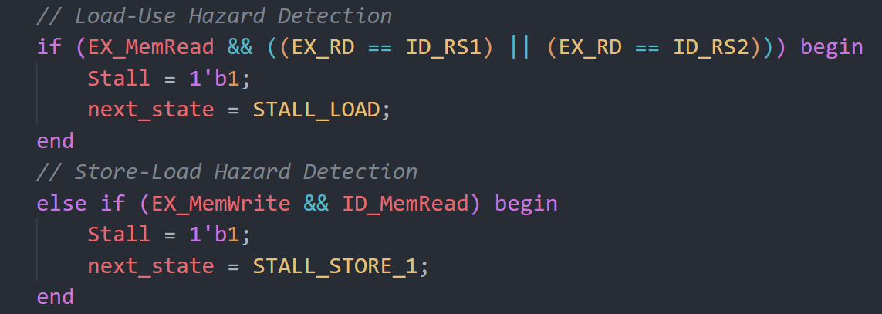
A FSM Hazard Detection Unit (Mealy Machine)
FSM will stay in IDLE STATE if no hazard or control hazard, in control hazard it will flush the register walls
STALL
LOAD
1
STALL
LOAD
2
FSM will enter STALL_LOAD state when encounter load-use hazard, and then enter clear state, stalling processor for 2 cycles
FSM will enter STALL_LOAD_1 state when encounter store-load hazard, and then enter STALL_LOAD_2 state, finally clear state, stalling processor for 3 cycles
IDLE
CLEARSTALL
STALL
LOAD

Slide 5
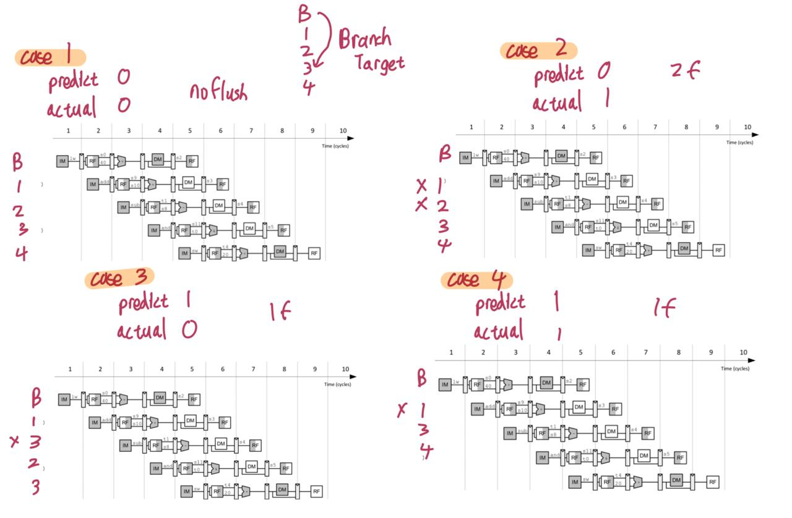
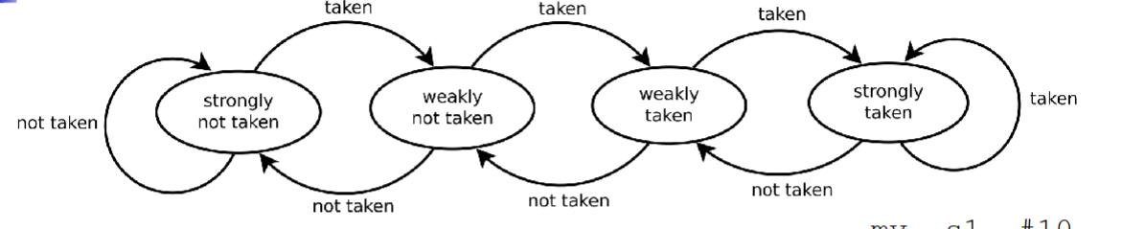
2-bit Dynamic Branch Predictor
Reduces the wasted cycles from always 2 to now potentially 0 for conditional branches
Starts here

